Slide 1
High Performance Computing with R (Session 1)
Jason Hou-Liu
Department of Statistics and Actuarial Science, University of Waterloo

Slide 2
Files on GitHub
There are 3 R Markdown files to refer to
github.com/jhouliu/ssc2023

Slide 3
Why is R good?
R is a high-level language
Very user-friendly
Lots of input validation
Targets non-programmers
Interpreted language

Slide 4
Why is R slow?
R is a high-level language
Very user-friendly
Lots of input validation
Targets non-programmers
Interpreted language
R is a high-level language
Very user-friendly
Lots of input validation
Targets non-programmers
Interpreted language

Slide 5
Why Bother?
Presumption: Your code already works, but is slow.
Leave it be
Grab a coffee while you wait
Tinker with it to make it go faster
Might break your code!

Slide 6
Goals
Session 1: Quantify performance and identify problems
Session 2: Improve performance by improving runtime efficiency
Session 3 & 4: Improve performance by distributing the work

Slide 7
Pre-requisites and Setup

Slide 8






Software Requirements
R and RStudio
Any reasonably recent version
Rtools (Windows) or Xcode (Mac) or gcc (Linux/BSD)
SSH/SCP tool
Built-in to recent operating systems
PuTTY and FileZilla

Slide 9
R Package Requirements
On your own computer…
Main R packages we need:
Rcpp, RcppArmadillo, Rfast, Rfast2, pbapply, profvis, bench

Slide 10
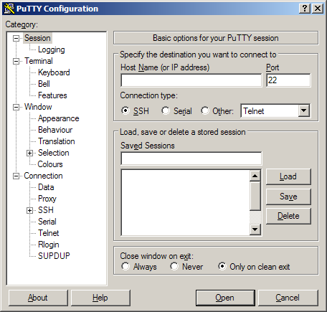
Cluster Access (via PuTTY)
Verify you have cluster access using the Carleton credentials
Open PuTTY
Host Name:
ssc-workshop.math.carleton.ca

Slide 11
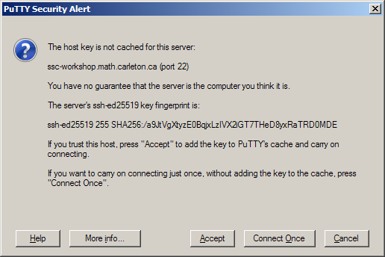
Cluster Access (via PuTTY)
You should get a security alert
Accept
In practice, you should always verify the SHA256 fingerprint
ssh-ed25519 255 SHA256:/a9JtVgXtyzE0BqjxLzIVX2iGT7THeD8yxRaTRD0MDE

Slide 12
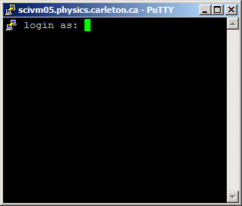
Cluster Access (via PuTTY)
Enter your username and password at the prompt
Paste by right-clicking, not Ctrl+V!
(Copy by selecting)

Slide 13
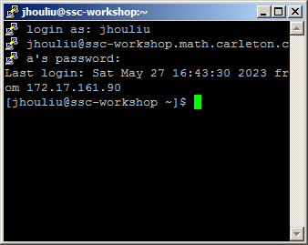
Make sure you are able to get to this prompt
[username@ssc-workshop ~]$

Slide 14
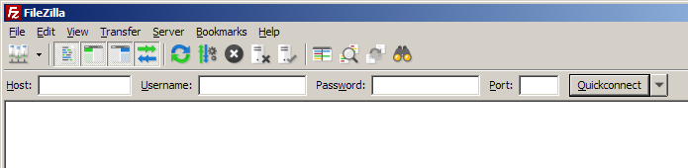
Cluster Access (via FileZilla)
Switch to FileZilla
Host:
ssc-workshop.math.carleton.ca
Port 22

Slide 15
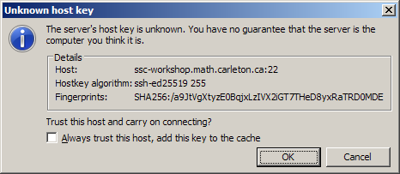
Again, trust this host.
In practice, always verify the fingerprint

Slide 16
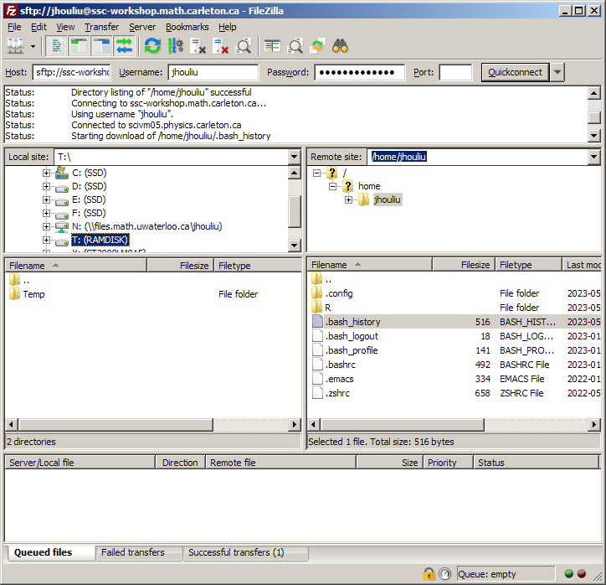
Cluster Access (via FileZilla)
Make sure you can see something like this:

Slide 17
Cluster Access (via FileZilla)
The left side is your local computer
The right side is the remote cluster
Can transfer files by dragging and dropping

Slide 18
Troubleshooting
Pause for a moment to troubleshoot
Make sure your R is working!

Slide 19
General guidance

Slide 20
Writing Functions
Treat R language as a functional language
Avoid side effects and ‘global’ variables
Break your code into manageable, meaningful functions
Well-defined inputs, well-defined outputs
Caveats: Random number generator, seeds

Slide 21
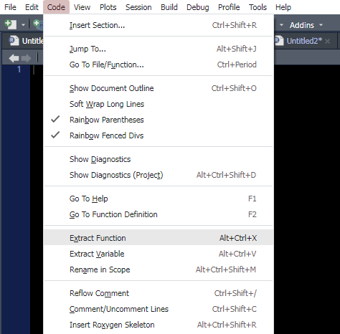
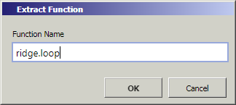
General Guidance – Foundational Strategies
n <- 100 p <- 5 X <- matrix(rnorm(n*p), n, p) y <- c(X %*% runif(p)) lam <- seq(0, 1, length.out = 100) beta <- list() for (i in seq_along(lam)) { XTX <- crossprod(X) + lam[i] * diag(p) XTy <- crossprod(X, y) beta[i] <- solve(XTX, XTy)
}
n <- 100 p <- 5 X <- matrix(rnorm(n*p), n, p) y <- c(X %*% runif(p)) lam <- seq(0, 1, length.out = 100) ridge.loop <- function(lam, X, p, y) { beta <- list() for (i in seq_along(lam)) { XTX <- crossprod(X) + lam[i] * diag(p) XTy <- crossprod(X, y) beta <- solve(XTX, XTy) } }
Specify the desired output and return it!
Congratulations! Your new function has explicit inputs and outputs!

Slide 22
General Guidance – Foundational Strategies
Why?
Easier to debug
Easier to test
Easier to re-factor
Easier to parallelize
Easier to profile
Clear inputs/outputs reduce possible scope of error
Bite-size functions are easier to digest

Slide 23
General Guidance – Foundational Strategies
Why?
Easier to debug
Easier to test
Easier to re-factor
Easier to parallelize
Easier to profile
Have a pathological input?
e.g.) Near-singular matrix inversion
Isolate the problem function
Re-run and debug one function in isolation

Slide 24
General Guidance – Foundational Strategies
Why?
Easier to debug
Easier to test
Easier to re-factor
Easier to parallelize
Easier to profile
Guarantee the same output for the same input
Doesn’t matter what happens inside the function

Slide 25
General Guidance – Foundational Strategies
Why?
Easier to debug
Easier to test
Easier to re-factor
Easier to parallelize
Easier to profile
Call the same function lots of times in a loop?
Parallelization candidate

Slide 26
General Guidance – Foundational Strategies
Why?
Easier to debug
Easier to test
Easier to re-factor
Easier to parallelize
Easier to profile
Figure out which function is slow
Timing by action instead of line of code
Easier to refactor

Slide 27
Benchmarking

Slide 28
Benchmarking
To get high performance, we need to quantify performance
Measure the time it takes to do something.
Sounds simple, but there are pitfalls.

Slide 29
Benchmarking
Ways to benchmark
system.time()
proc.time()
microbenchmark
bench

Slide 30
Benchmarking
system.time()
Output
set.seed(1)
p = 2000
X = rWishart(1, p, diag(p))[,,1]
time1 <- system.time({
eigen(X)
})
time2 <- system.time({
eigen(X, only.values = TRUE)
})
> time1
user system elapsed
7.27 1.84 2.46
> time2
user system elapsed
3.71 0.28 1.11

Slide 31
Benchmarking
proc.time()
Output
time1 <- proc.time()[[“elapsed”]]
eigen(X)
time1b <- proc.time()[[“elapsed”]]
time2 <- proc.time()[[“elapsed”]]
eigen(X, only.values = TRUE)
time2b <- proc.time()[[“elapsed”]]
> time1b - time1
[1] 2.05
> time2b - time2
[1] 0.95

Slide 32
Benchmarking
tictoc package
Output
library(tictoc)
tic()
e1 = eigen(X)
toc()
tic()
e2 = eigen(X, only.values = TRUE)
toc()
> tic()
> e1 = eigen(X)
> toc()
2.7 sec elapsed
>
> tic()
> e2 = eigen(X, only.values = TRUE)
> toc()
1.13 sec elapsed

Slide 33
Benchmarking
Great for benchmarking a single run
Be a frequentist, repeat the experiment!

Slide 34
Benchmarking
microbenchmark package
library(microbenchmark)
microbenchmark(
e1 = eigen(X),
e2 = eigen(X, only.values = TRUE),
times = 10
)
Output
Unit: milliseconds
expr min lq mean median uq max neval
e1 1879.2925 2087.1273 2167.3595 2180.8204 2262.4268 2485.6963 10
e2 843.8819 868.9814 895.7841 904.4995 917.0683 937.7318 10

Slide 35
Benchmarking
Summarizing across replications is good…
But outliers tend to happen!

Slide 36
Benchmarking
microbenchmark package
microbenchmark(
e1 = eigen(X[1:50, 1:50]),
e2 = eigen(X[1:50, 1:50], only.values = TRUE),
times = 1000
)
Output
Unit: microseconds
expr min lq mean median uq max neval
e1 768.825 941.7760 1273.0369 1134.3285 1402.689 19531.46 1000
e2 546.088 670.2935 925.6897 821.5605 1045.858 17582.69 1000

Slide 37
Benchmarking
Summarizing across replications is good…
But outliers tend to happen!
Run-to-run variance…
Background processes
R’s garbage collector
Hardware reasons

Slide 38
Benchmarking
bench package
bench::mark(
e1 = eigen(X[1:50, 1:50]),
e2 = eigen(X[1:50, 1:50], only.values = TRUE),
min_time = 10,
check = FALSE
)
Output
# A tibble: 2 x 13
expression min median `itr/sec` mem_alloc `gc/sec` n_itr n_gc total_time
<bch:expr> <bch:tm> <bch:> <dbl> <bch:byt> <dbl> <int> <dbl> <bch:tm>
1 e1 758us 857us 1115. 224KB 3.69 9967 33 8.94s
2 e2 518us 570us 1671. 184KB 5.36 9968 32 5.96s
# i 4 more variables: result <list>, memory <list>, time <list>, gc <list>

Slide 39
Benchmarking
Brief description of bench::mark’s parameters
min_time
iterations
min_iterations
max_iterations
check
filter_gc

Slide 40
Profiling

Slide 41
Profiling
Benchmarking gives you the total runtime
What about more complicated code?
How do we identify slow portions of code?

Slide 42
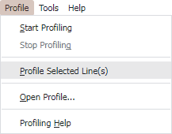
Profiling
# Define the IRLS function
logistic.irls = function(X, y, beta = rep(0, ncol(X)), iters) {
for (i in 1:iters) {
p = as.numeric(plogis(X %*% beta))
hessian = t(X) %*% (X * (p * (1 - p)))
gradient = t(X) %*% (y - p)
beta = beta + solve(hessian, gradient)
}
return(beta)
}
# Profile this function
logistic.irls(X, y, iters = 100)

Slide 43
Profiling
How does it work?
Runs your code as usual
Every 10 ms (default), look at what function is currently running
Obtain a systematic sample over time

Slide 44
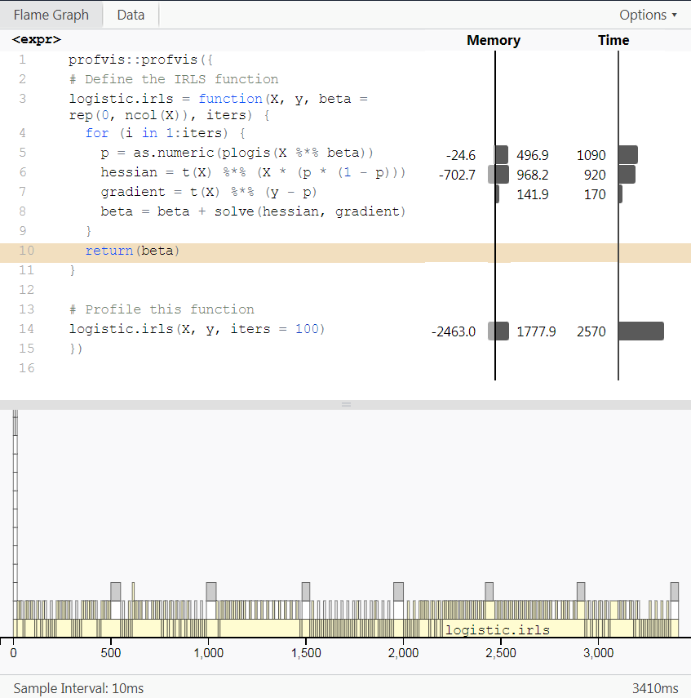
Profiling
This is a profiled result
Interactive
Can be saved and reloaded
Interpret each part piece-by-piece

Slide 45
Profiling
Expression column
Your code
Will only include lines in the profile
Helpful for identifying slow lines of code

Slide 46
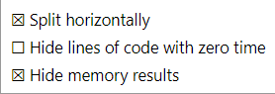
Profiling
Memory column
Tracks memory usage
Allocation & Deallocation
We’ll ignore this for now
Can hide it in RStudio

Slide 47
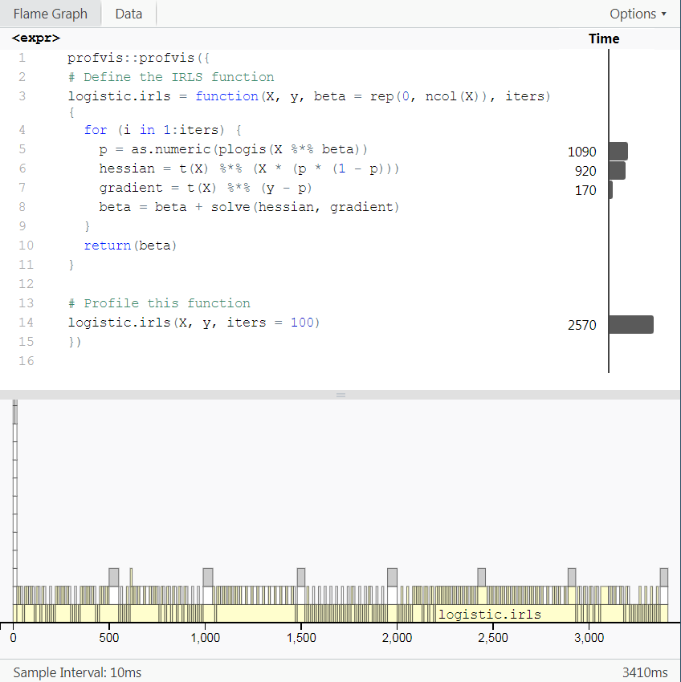
Profiling
Time column
Amount of sampled time spent on this line of code
Units of milliseconds
Recall: 10 ms samples
Times are counted more than once in nested functions!

Slide 48
Profiling
Flame graph
function(t)
Visual trace of what executed when
Usually unreadable for lots of fast iterations

Slide 49
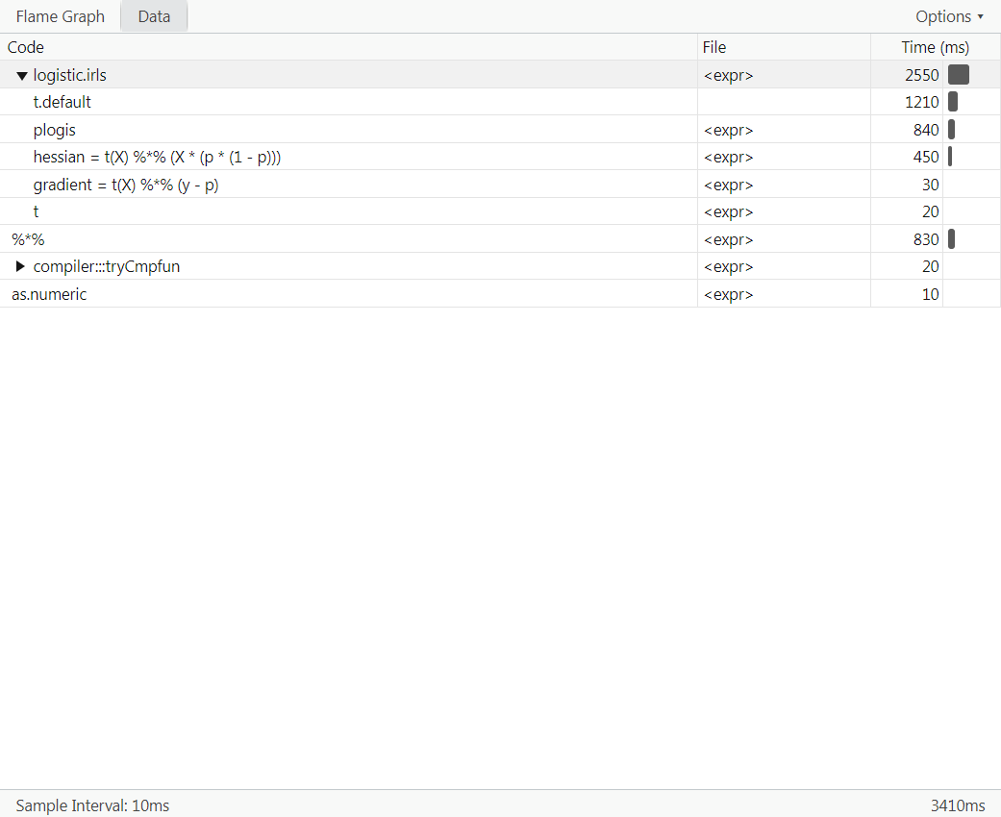
Data tab
Times by function call
Helpful if you’ve adopted a highly functional coding structure
Again, times are nested!

Slide 50
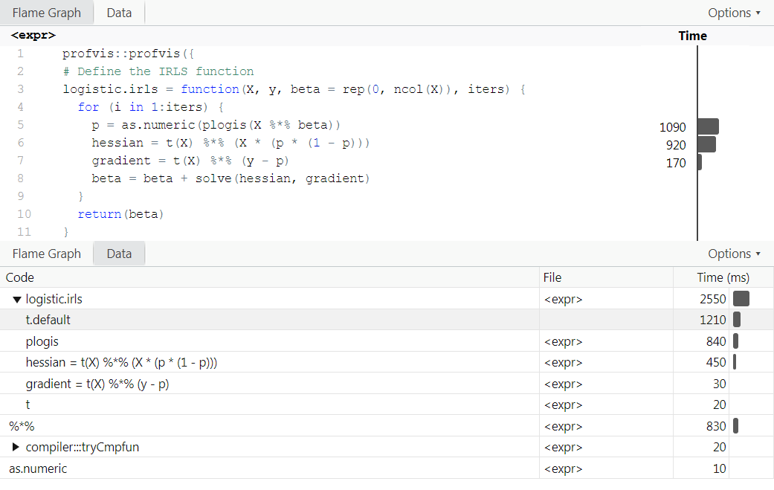
Profiling
Using the profile
Hessian and gradient are slow
Most of the blame is on t.default
Recall:
crossprod(x,y) = t(x) %*% y

Slide 51
Profiling
Original
Using crossprod
logistic.irls = function(
X, y, beta = rep(0, ncol(X)), iters) {
for (i in 1:iters) {
p = as.numeric(plogis(X %*% beta))
hessian = t(X) %*% (X * (p * (1 - p)))
gradient = t(X) %*% (y - p)
beta = beta + solve(hessian, gradient)
}
return(beta)
}
logistic.irls.2 = function(
X, y, beta = rep(0, ncol(X)), iters) {
for (i in 1:iters) {
p = as.numeric(plogis(X %*% beta))
hessian = crossprod(X, X * (p * (1 - p)))
gradient = crossprod(X, y - p)
beta = beta + solve(hessian, gradient)
}
return(beta)
}

Slide 52
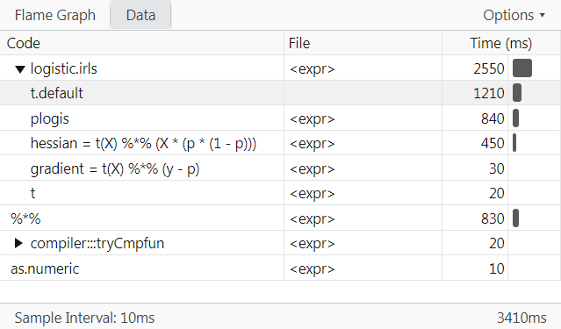
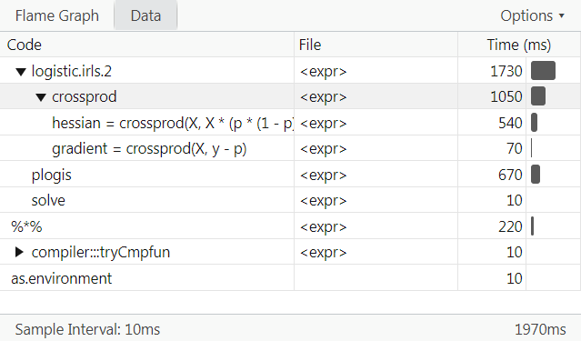
Profiling
Original
Using crossprod

Slide 53
Profiling
> bench::mark(
+ original = logistic.irls(X, y, iters = 100),
+ crossprod = logistic.irls.2(X, y, iters = 100),
+ filter_gc = FALSE,
+ min_iterations = 5
+ )
# A tibble: 2 x 13
expression min median `itr/sec` mem_alloc `gc/sec` n_itr n_gc total_time
<bch:expr> <bch:tm> <bch:tm> <dbl> <bch:byt> <dbl> <int> <dbl> <bch:tm>
1 original 2.5s 2.61s 0.381 2.53GB 8.07 5 106 13.14s
2 crossprod 1.68s 1.7s 0.572 1.04GB 5.03 5 44 8.74s
# i 4 more variables: result <list>, memory <list>, time <list>, gc <list>

Slide 54
Profiling
Hands-on practice:
Can this function be further optimized?
Profile R’s built-in glm.fit function
Profile your own code

Slide 55
Profiling
Coffee break!
Trick:
plogis(X %*% beta)
(tanh(X %*% beta / 2) + 1) / 2

